Slide 1

WEB DESIGN WORKSHOP(K24IT12P) Second Hand Book Exchange Website
Submitted by: Submitted to:
Vinay Rathore Mayank Lakhotia Sir

Slide 2

Second Hand Book Exchange Website: A Design Journey
Welcome to our presentation outlining the design process for a Second Hand Book Exchange website. We will explore the needs of our users, the website's features, and the creative journey from ideation to testing.

Slide 3
INDEX
S.No. | Sub S.No. | Contents
1. |  | Design Thinking Process
2. |  | Empathize
 | (i) | Enhancing Engagement: Website Features
 | (ii) | Empathy Map
 | (iii) | User Persona
3. |  | Define
 | (i) | What is the Problem?
 | (ii) | Who are we solving for?
4. |  | Ideate
5. |  | Prototype
6. |  | Test and Feedback

Slide 4
Agenda: Navigating the Design Process
1
Empathy
2
Define
3
Ideate
Understanding the needs and motivations of our users.
Formulating a clear vision and point of view for the website.
Generating creative ideas and exploring various design solutions.
4
Prototype
5
Test
Creating a working model to test and refine the website's functionality.
Gathering user feedback and iterating on the design based on insights.

Slide 5
Empathy: Understanding the Users
Client Requirements
Possible Solutions
Client Questions
What features are essential for the client to achieve their goals? What are their specific expectations for the website's functionality, design, and user experience?
What are the potential solutions that meet the client's requirements? How can we incorporate innovative ideas and technology to enhance the user experience?
What questions do clients have about the design process and website functionality? How can we effectively address their concerns and provide clear explanations?

Slide 6
Enhancing Engagement: Website Features
User-Friendly Interface
Environmental Impact
A simple and intuitive design that allows users to easily navigate and search for books. This could include features such as a filter system, search bar, and clear category organization.
Sustainability: encouraging a reduction in waste.
how reusing books contributes to the reduction of carbon footprints and deforestation, as well as eco-friendly packaging.
Affordability
Many people might not have the budget to buy new
Books but are eager to read. By creating a second-hand
exchange. you're offering a way for individuals
User-Centered Focus
Consider that people who exchange second-hand books
may have varying needs.
Some might be looking for rare or specific titles. Design
with these different needs in mind.

Slide 7





Empathy Map: Unveiling User Needs
Thinks
Feels
Says
Does
Users think about finding affordable books, discovering hidden gems, and connecting with other book lovers.
Users might feel excited to find a rare book, frustrated by limited options, or happy to find a book they've been searching for.
Users might say things like "I'm looking for a good deal on a used book", "I wish there was an easier way to find books in my area", or "I love finding rare books I can't find anywhere else."
Users might browse online marketplaces, visit local bookstores, or ask friends for recommendations.

Slide 8
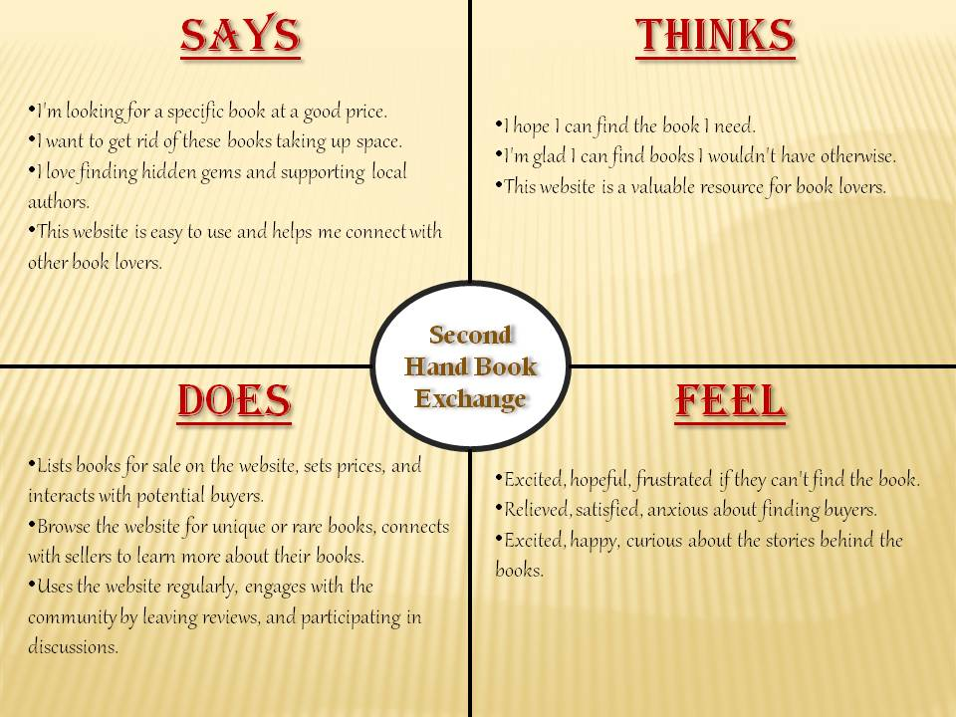
Empathy Map

Slide 9




User Persona: Meet Sarah, the Bookworm
Sarah, 28, Book Lover
1
Sarah is a passionate reader who loves exploring new genres and authors. She enjoys finding unique books at affordable prices and wants to support a sustainable book exchange system.
Goals
2
Find affordable books, discover new authors, support sustainable book exchange.
Frustrations
3
Limited book selection, high shipping costs, difficulty finding books in her area.
Needs
4
An easy-to-use website with a wide selection of books, local pickup options, and a sense of community.

Slide 10
Define - What is the Problem?
Problem Identification:
Accessibility Issues:
Lack of platforms connecting people.
Difficulty in locating specific books in second-hand markets.
Affordability Concerns:
High cost of new books.
Limited budget for students.
Environmental Impact:
Books discarded instead of reused, leading to unnecessary waste.
Community Disconnection:
Limited interaction among readers to share resources or recommendations.

Slide 11
Define - Who Are We Solving For?
Target Users:
Students:
Need affordable textbooks and access to academic resources.
Avid Readers:
Seek rare or out-of-print books at lower costs.
Book Collectors:
Interested in trading or finding specific editions.
Sustainability Advocates:
Motivated by reducing waste and promoting recycling.
Insights from Empathy Stage:
Users prioritize affordability, availability, and convenience.
Strong preference for an easy-to-use platform or system.

Slide 12
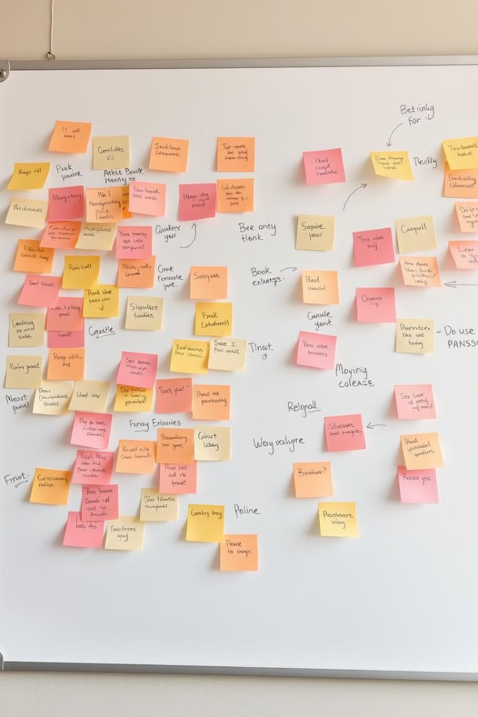




Ideate: Brainstorming Creative Solutions
User-Friendly Interface
Explore different layout options, navigation menus, and search features to create a seamless browsing experience.
Personalized Recommendations
Brainstorm algorithms that analyze user preferences and browsing history to suggest books tailored to their interests.
Community Features
Consider integrating social media features, forums, or book clubs to foster a sense of community among users.
Mobile Responsiveness
Design the website for optimal viewing on various devices, ensuring a smooth user experience for mobile users.

Slide 13
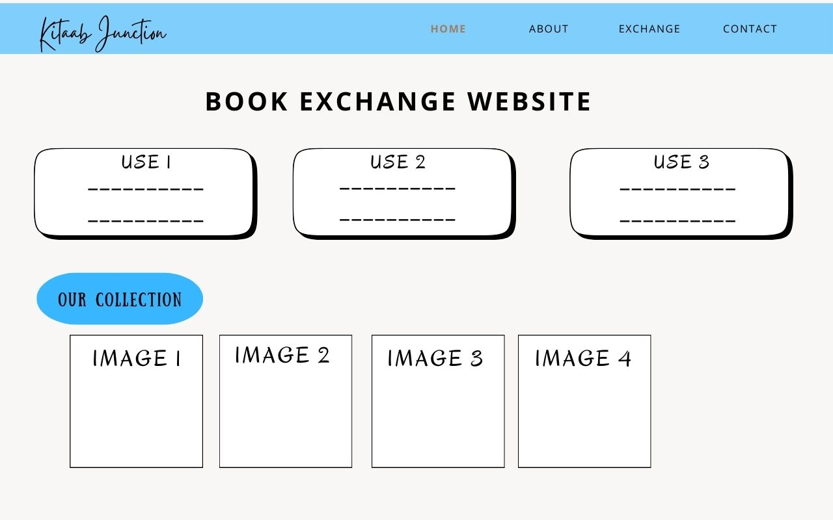
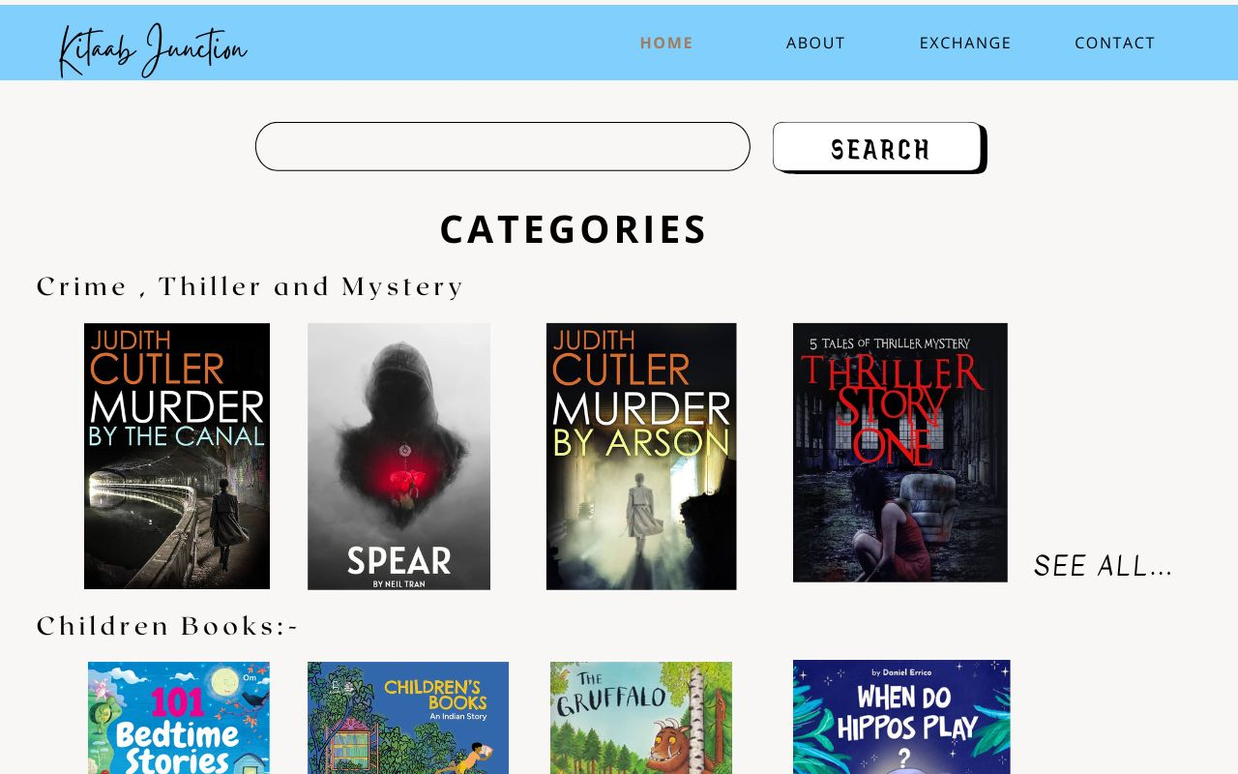
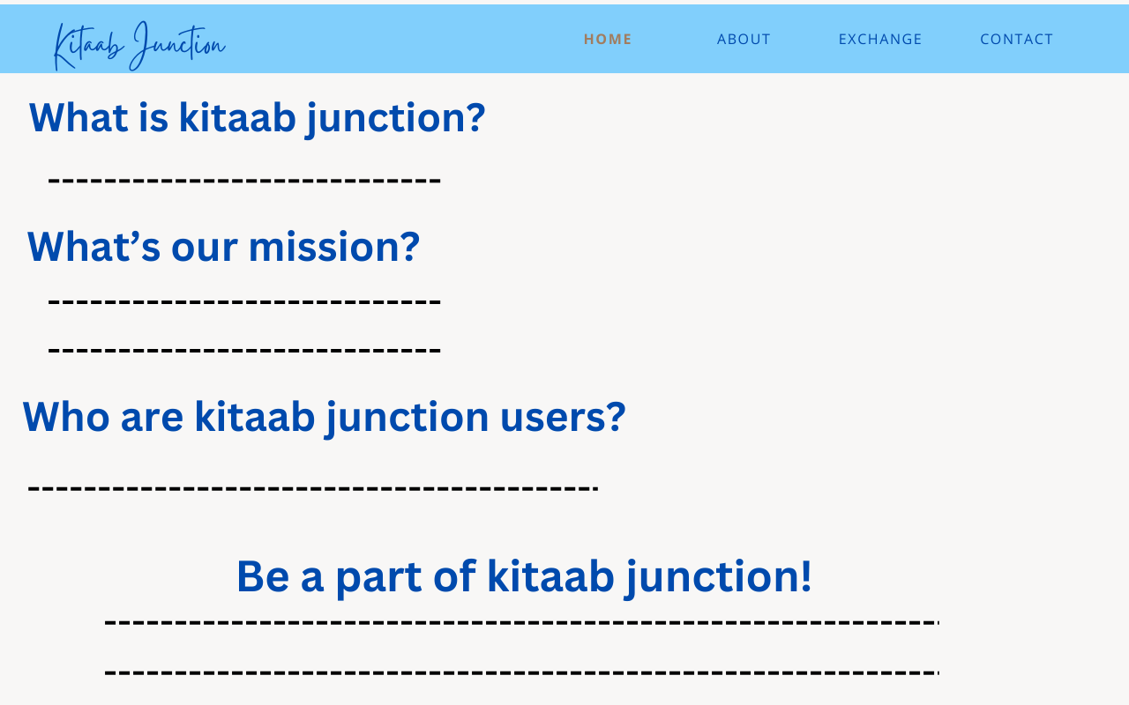
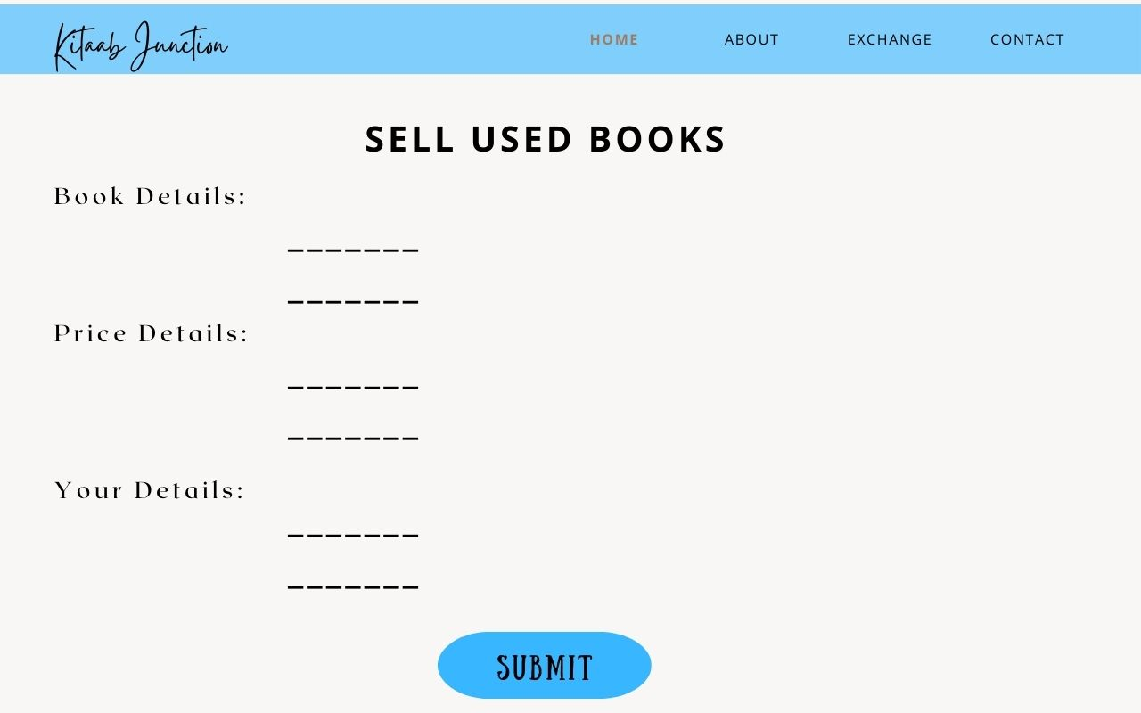

Slide 14
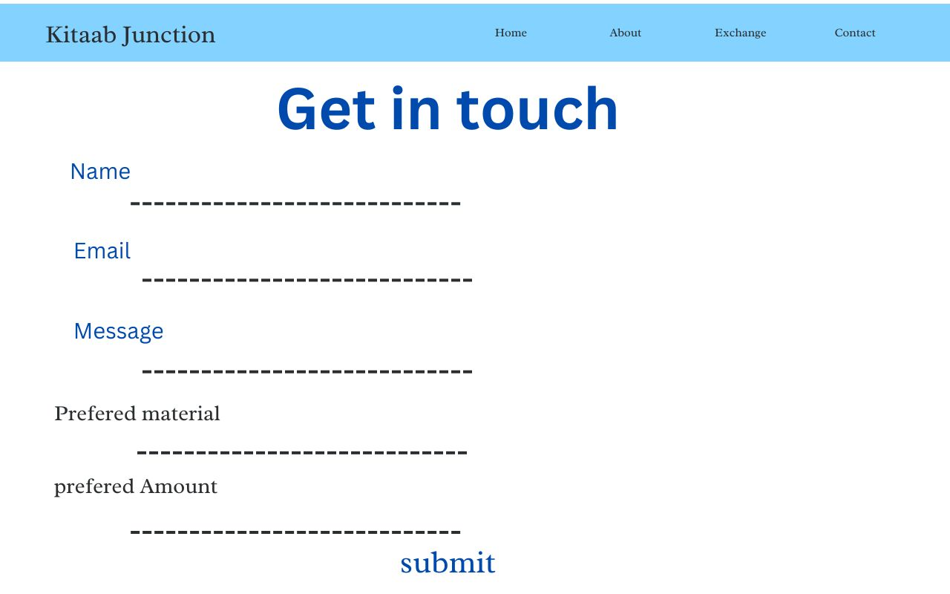
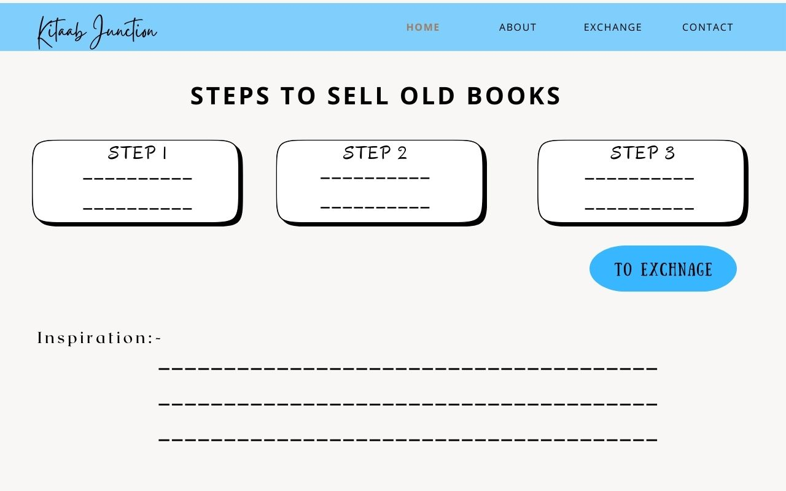
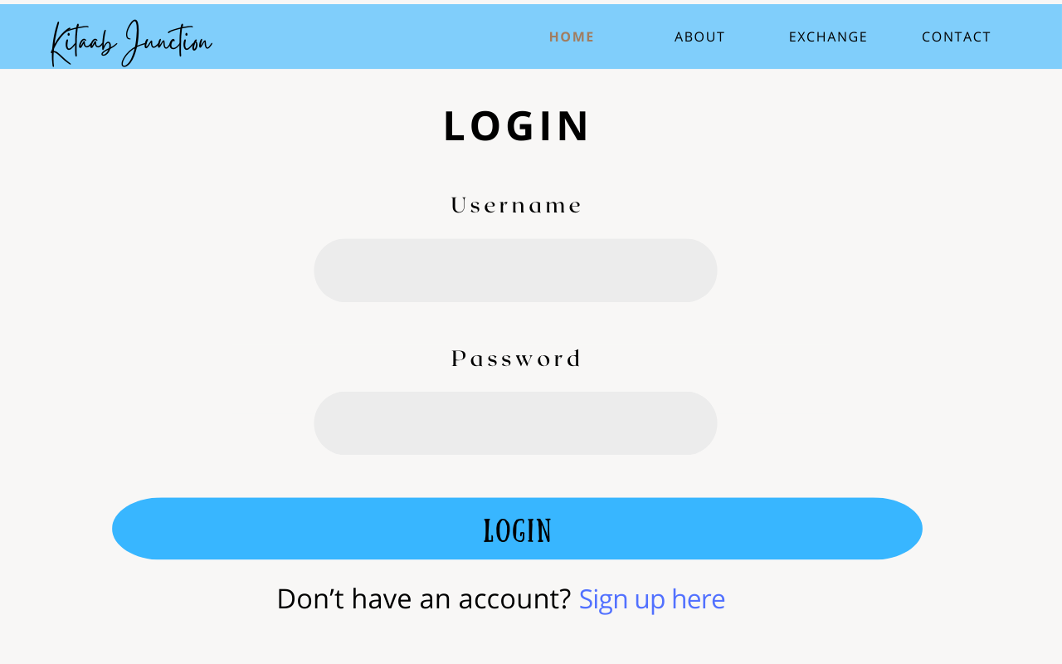
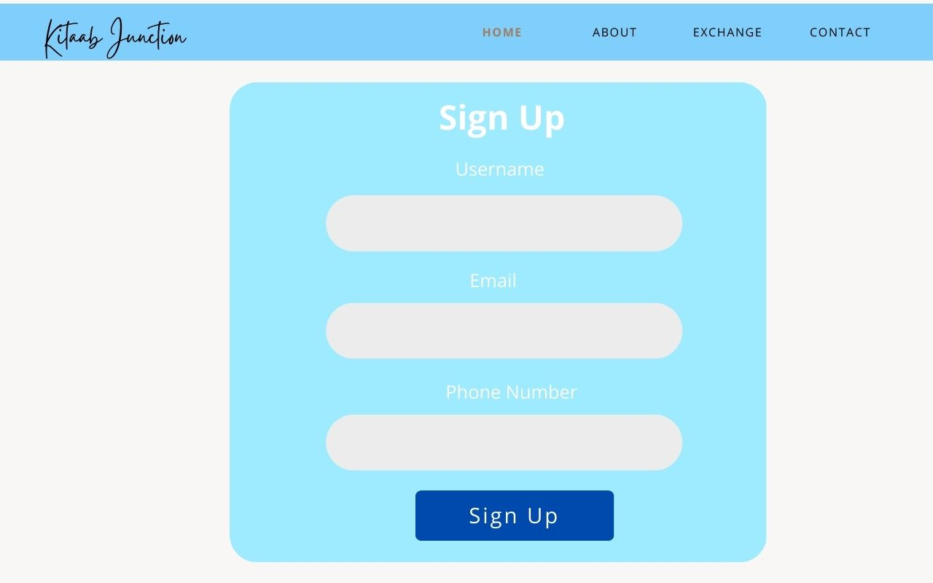

Slide 15
Prototype: Bringing the Vision to Life
1
2
3
Homepage
Search & Browse
Book Details
Showcase featured books, explore categories, and highlight community features.
Implement a user-friendly search bar, filter options, and clear category organization.
Display detailed information about each book, including descriptions, reviews, and purchase options.
4
5
6
User Profile
Exchange
Create Your Account
Allow users to manage their book lists, track reading progress, and connect with other book lovers.
Sell pre-loved books easily on kitaab junction by entering details, setting prices, and choosing payment and shipping options.
Create your own personalized account and buy or exchange books….

Slide 16
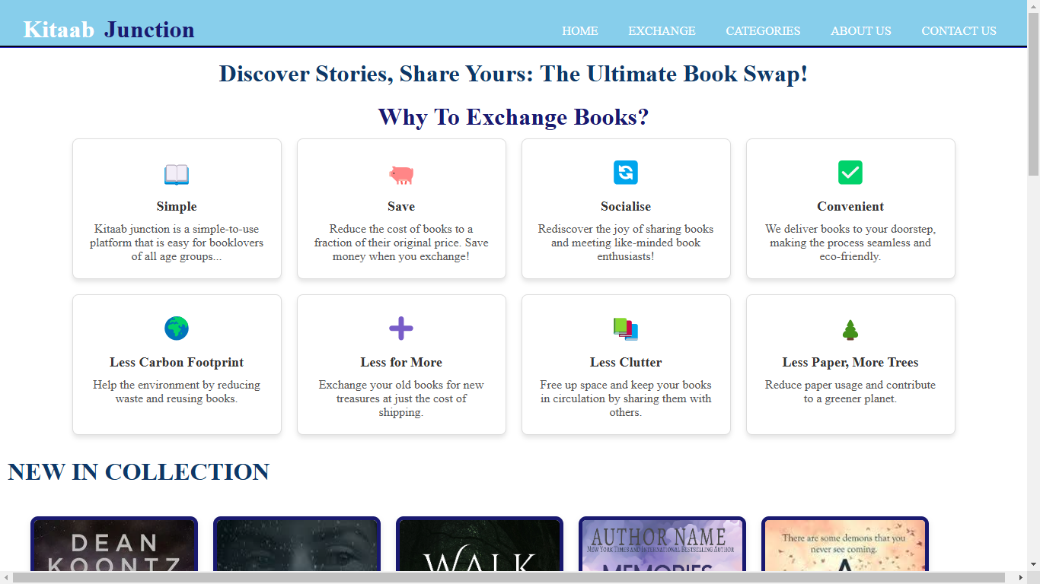
Home Page

Slide 17
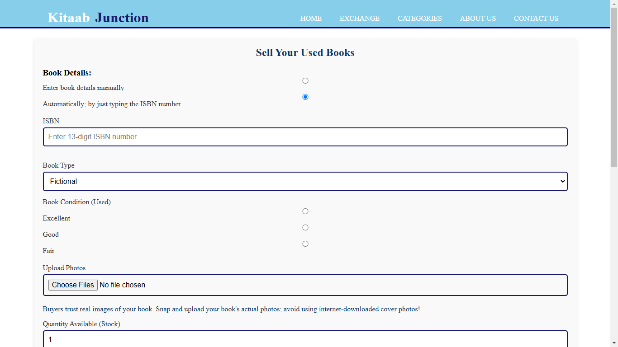
Exchange

Slide 18
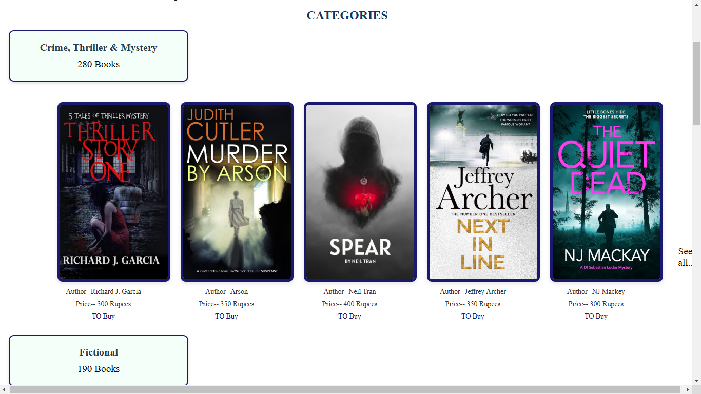
Categories

Slide 19
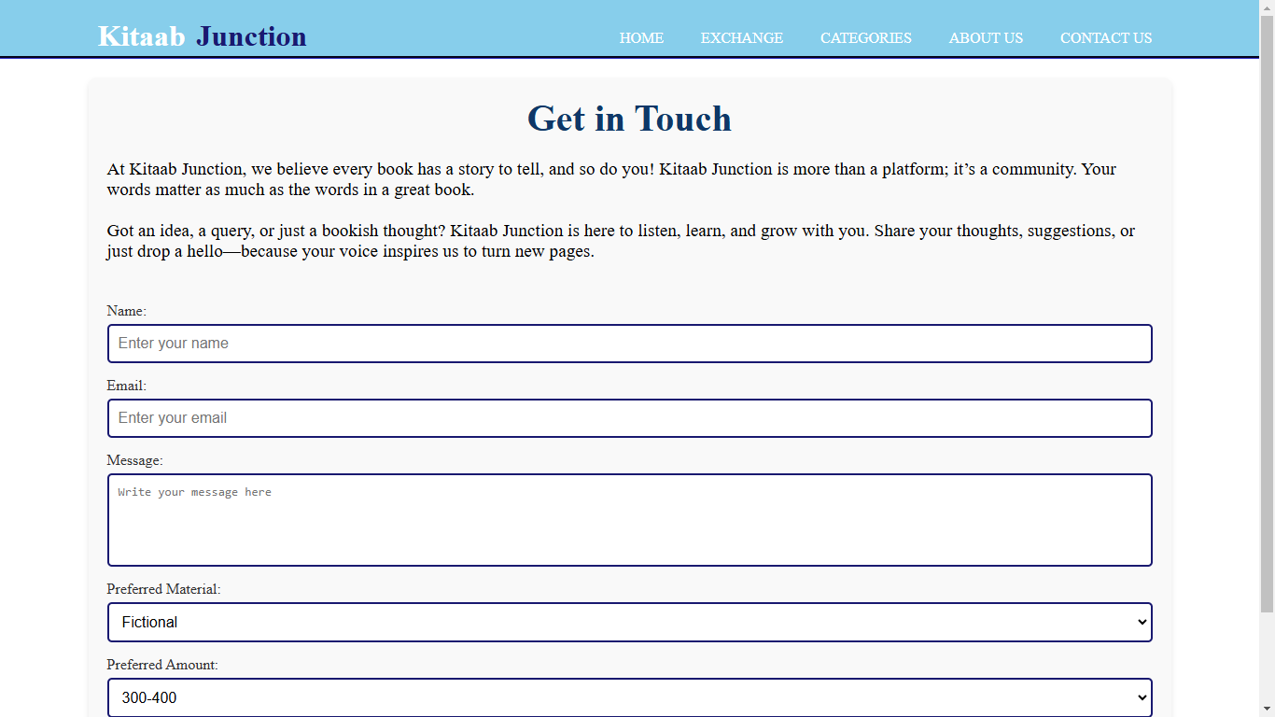
Contact Us

Slide 20
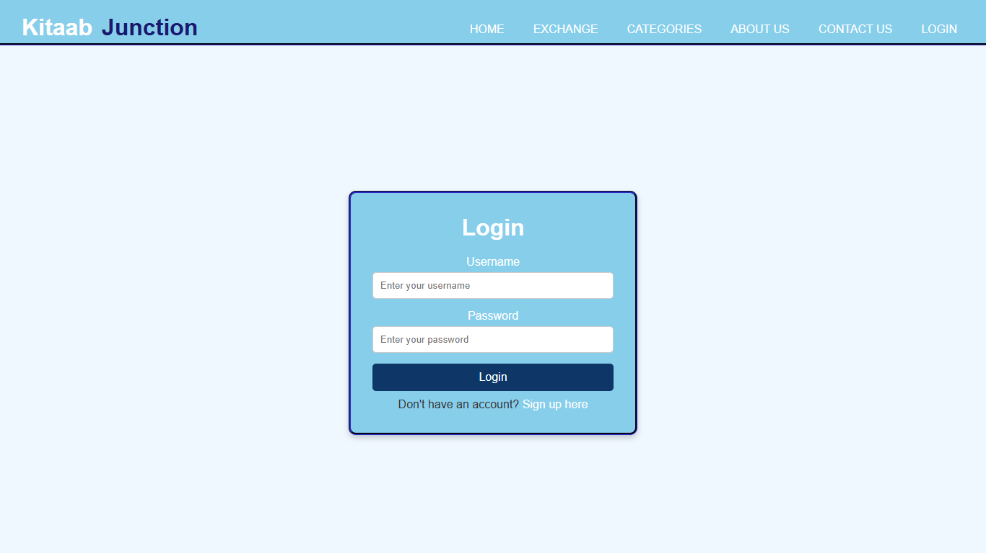
Login

Slide 21

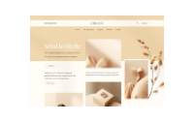

Test & Feedback: Refining the Design
We conducted Testing for our second-hand book exchange website with a set of users before the final submission. Gathering feedback helped us identify areas for improvement and ensure that our platform aligns with user needs.
Following are stated some feedbacks from our users

Slide 22
Feedback
User Interface (UI):
Positive: The design is clean and easy to navigate.
Negative: Fonts, buttons, or layout might not be user-friendly or visually appealing.
Improvement: Add consistent color schemes, improve readability, or make the design more modern
User Experience (UX):
Positive: Navigation is smooth and intuitive.
Negative: Users may struggle to find features like search, filters, or book categories.
Improvement: Add clear call-to-action buttons, simplify navigation, or optimize the user flow.
Performance:
Positive: The site loads quickly and works smoothly.
Negative: It might be slow on some devices or browsers.
Improvement: Optimize images, reduce code bloat, and use caching.
Book Listings:
Positive: Listings are detailed and well-organized.
Negative: Missing details like book conditions, images, or seller information.
Improvement: Make listing forms more comprehensive and encourage image uploads.

Slide 23
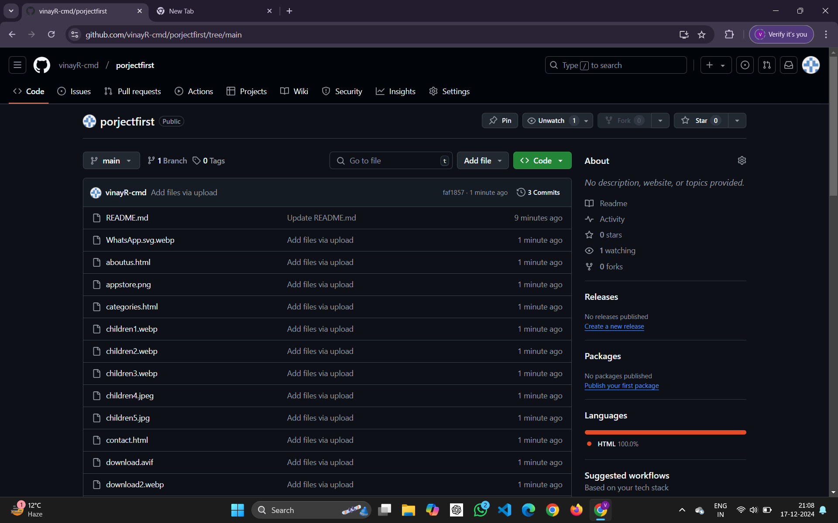
Explore my project on github for a detailed look
https://github.com/vinayR-cmd/porjectfirst

Slide 24
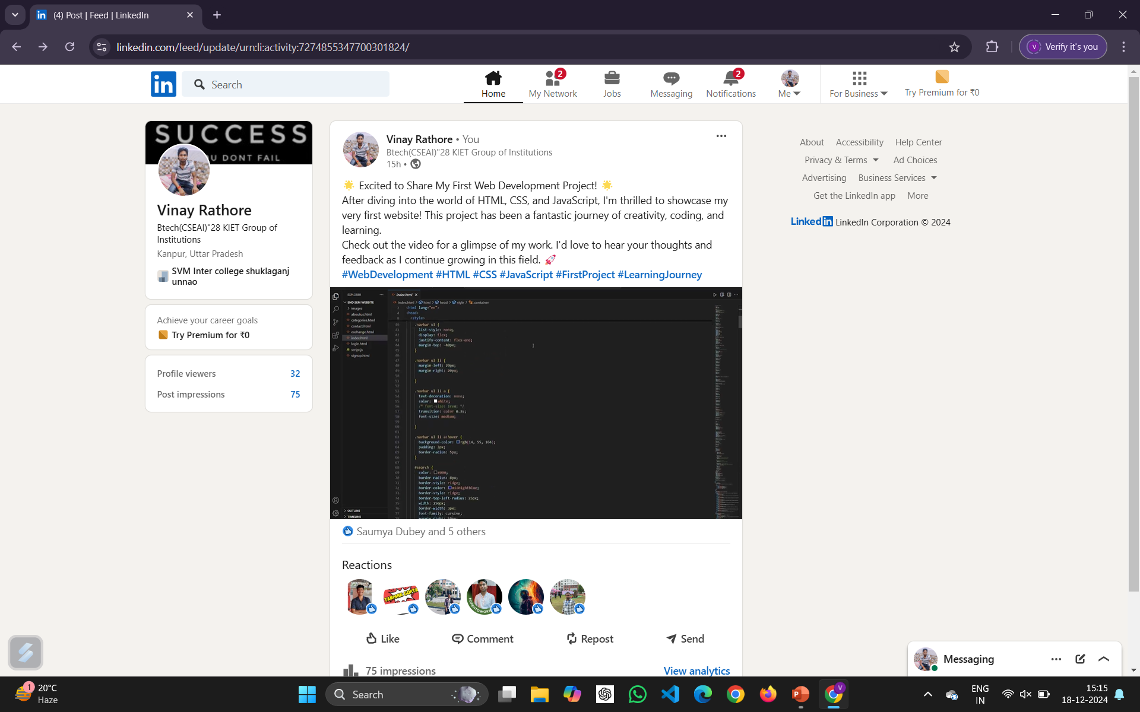
Connect to my linkedin and like my post
https://www.linkedin.com/in/vinay-rathore-14249b328/recent-activity/all/

Slide 25
Thank You!

